Slide 1
Middle Housing in Wilsonville
Wilsonville Planning Commission
Work Session
May 12, 2021

Slide 2
Topics for Discussion
Draft Code & Plan Updates – focus on Category 1 and 2
Online survey results
Middle housing percentage requirement in Frog Pond West

Slide 3
Desired Project Outcomes
Thoughtful, inclusive built environment
House Bill 2001 compliance
Meet housing needs
Impactful public outreach
Infrastructure to support middle housing
Usable standards
Minimize parking congestion

Slide 4
Code + Plan Updates: Four Categories
Category 1: Direct requirement for state compliance, no significant local flexibility.
Key Focus
Category 2: Indirect requirement for state compliance, no significant local flexibility. Make middle housing development feasible or acknowledge allowance of middle housing.
Also in packet:
Some minor updates & areas where PC already provided clear direction
Category 3: Requirement of state compliance with local flexibility.
Category 4: Not necessary for compliance or feasibility, but intended to improve the code or provide technical updates.

Slide 5
Future Work Session(s)
Remaining Category 3 and 4 updates
Draft siting and design standards (special focus on design standards)
Frog Pond West Master Plan updates
Residential Neighborhood (RN) Zone updates

Slide 6
Drivers of Category 1 & 2 Updates
Clearly defining terms for middle housing
Establishing middle housing as an allowed use in all residential zones
Updating the review process for middle housing
Incorporating density exemptions for middle housing
Updating siting and design standards based on limits set by the State
Establishing status of previous planned development approvals
Referencing recent housing policy updates
Notes:
As Dan mentioned, we will be focusing primarily on Category 1&2 updates tonight.
These updates are either directly or indirectly required for compliance with HB 2001. And these are areas in which the city has the least amount of flexibility.
Your packet includes draft amendments to the development code, comprehensive plan, master plans, and neighborhood plans.
It’s a lot of detailed information, so tonight we wanted to give a general overview of the proposed changes, make sure you understand the issues, and answer any questions you might have.
So, the main drivers of these updates are … [see slide]

Slide 7
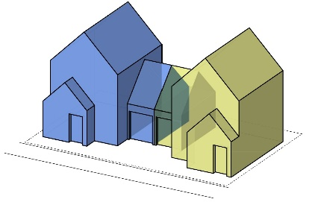
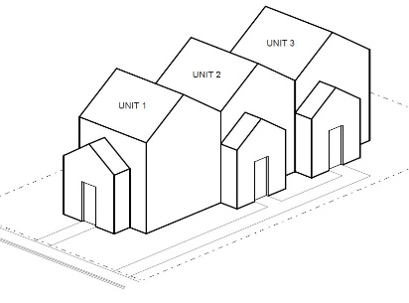
Middle Housing Terms [WC 4.001]
Separate triplex and quadplex from multi-family and add new definitions
Add definitions for “detached plexes” (2-unit, 3-unit, and 4-unit cluster housing)
Add definition of cottage cluster consistent with state law
Update existing terms for consistency with state law and to better differentiate housing types (duplex, townhouse, etc.)
Add secondary terms used in middle housing regulations (e.g., common courtyard)
Replace “family” with “household” to be more inclusive of different living arrangements
Notes:
First, we’ll go over updates to middle housing terms—these are updates to the Definitions section of the Wilsonville Code and are reflected throughout the draft amendments.
Recognizing Middle housing as a separate class of housing that falls somewhere in between single-family and multi-family requires some changes to the way terms are defined.
This includes … [see slide]

Slide 8
Establish Middle Housing as an Allowed Use in Residential Zones
Add middle housing types to list of permitted uses:
Residential (R) Zone [WC 4.122]
Old Town Residential (OTR) Zone [WC 4.123—new]
Planned Development Residential Zones (PDR-1 – PDR-6) [WC 4.124]
Village (V) Zone [WC 4.125]
Residential Neighborhood (RN) Zone [WC 4.127—not in packet]
Notes:
[read through slide]
The RN zone is not included in your packet because a lot of the changes that are needed fall into Category 3—areas for where the city has more flexibility and choices to make—and because the discussion about density and middle housing requirements in Frog Pond are still ongoing. So, we’ll bring forward the draft amendments to the RN zone at our next work session.

Slide 9
Update Review Process for Middle Housing
Per state law, must apply same approval process to middle mousing as applies to detached single-family dwellings
Single-family and two-family dwellings currently subject to Class I ministerial review and exempt from Site Design Review
Apply same review process / exemption to middle housing [WC 4.030 and 4.420]
Notes:
According to state law, cities must subject middle housing to the same review process as applies to detached single-family housing.
Currently single-family and two-family dwellings (or duplexes) are subject to Class I ministerial review, which is essentially a building permit review that’s done without notice to neighboring property owners, and with a decision made by staff.
The updates apply this Class I review process to all middle housing types, and also clarify that middle housing, like detached single-family housing, is not subject to Site Design Review.
Multi-family housing that has five or more units will continue to go through Site Design Review.

Slide 10
Incorporate Density Exemptions for Middle Housing
Per state law:
Duplexes, triplexes, quadplexes, and cottage clusters must be exempt from density maximums.
Minimum lot size will control density.
Townhouses can be limited to 4x density for single-family dwellings or 25 units per acre, whichever is less.
25 units/acre ≈ 1,750 sf per townhouse lot
Notes:
Another key provision of the state rules is that cities must exempt duplexes, triplexes, quadplexes, and cottage clusters from density maximums. So, for these middle housing types, the minimum lot size will control density rather than regulating it by maximum dwellings per acre.
For townhouses, the rules do allow density to be limited, but cities must allow at least four times the allowed density for detached single-family dwellings or 25 units per net acre, whichever is less.
The draft amendments incorporate these exemptions and special provisions in the various references to density within the Comprehensive Plan and Development Code.
[example on next slide]

Slide 11
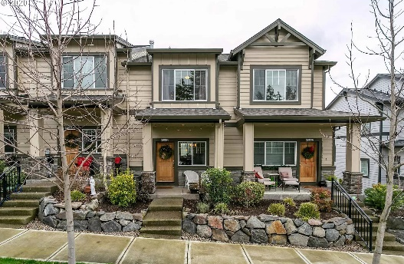
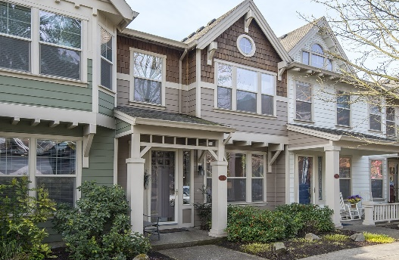
Incorporate Density Exemptions for Middle Housing
Examples of resulting townhouse density in PDR zones:
 | Max Density for Single-Family | Max Density for Townhouse
PDR-1 | 1 | 4
PDR-2 | 3 | 12
PDR-3 | 5 | 20
PDR-4 | 7.5 | 25
PDR-5 (10-12 du/ac) | 12 | 25
PDR-5 (16-20 du/ac) | 20 | 25
PDR-6 | As approved (at least 25) | 25
Notes:
We wanted to give an example of how the townhouse density regulations play out in the PDR zones.
As you can see in the table, for the lower-density PDR zones (PDR-1 through PDR-3), the maximum density for townhouses will be four times the density for single-family.
For the higher-density zones (PDR-4 through PDR-6), four times the density for single-family would exceed 25 units per acre… so for those zones, density is capped at 25 units per acre.

Slide 12
Minimum Lot Size
Examples of minimum lot size updates:
 | OAR Compliance | PDR-2 Min lot size for SFD: 7,000 sf | PDR-4 Min lot size for SFD: 3,000 sf
Duplex & 2-unit cluster | Same as SFD | 7,000 sf | 3,000 sf
Triplex & 3-unit cluster | 5,000 sf (or same as SFD if >5,000 sf) | 7,000 sf | 5,000 sf
Quadplex, 4-unit cluster, Cottage Cluster | 7,000 sf (or same as SFD if >7,000 sf) | 7,000 sf | 7,000 sf
Townhouse | 1,500 sf | 1,500 sf | 1,500 sf
Notes:
Updates to minimum lot size standards required for compliance with the Administrative Rules
The green column in the table shows the minimum OAR compliance standards for each middle housing type.
Then the two blue columns to the right show examples of how minimum lot sizes have been updated in the PDR-2 and PDR-4 zones.
So, in PDR-2, the minimum lot size for a single-family home is 7,000 sf… so according to the rules, the City can apply this same minimum lot size to all middle housing types except townhouses.
For townhouses, the minimum lot size can’t exceed 1,500 sf.
In the PDR-4 zone, the minimum lot size for single-family homes is 3,000 sf.
So, the city must apply this same minimum lot size for duplexes and 2-unit clusters.
For triplexes, the city can require no more than 5,000 sf.
For quadplexes and cottages, the city can require no more than 7,000 sf.
And again, for townhouses, the minimum lot size can’t exceed 1,500 sf.

Slide 13
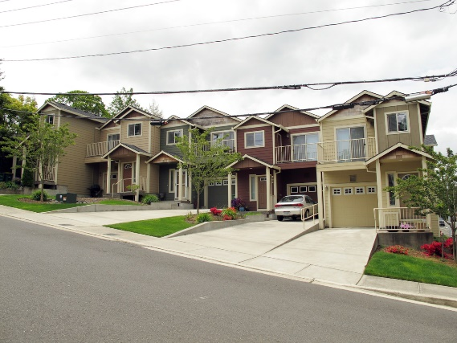
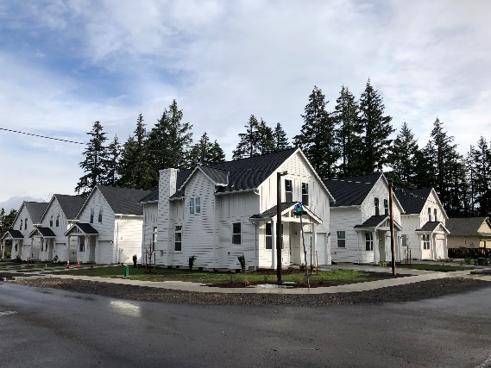
Other Siting Standards
Generally, siting standards (i.e., development standards) must be same as for single-family.
Some further limitations per OAR:
Height – Must allow at least two stories for triplex/quadplex and townhouse
Setback – Cottage cluster setbacks can’t exceed 10 ft
Lot dimensions – Lot width / lot frontage for townhouses can’t exceed 20 ft
Lot coverage – Cottage clusters must be exempt from lot coverage
These are reflected in all zone chapters
Notes:
In general, the state’s Administrative Rules require cities to apply the same siting standards (or development standards, as they’re called in the Wilsonville Code) to middle housing as apply to single-family housing.
However, the rules have some specific limitations that are reflected in the draft code amendments.
These include…

Slide 14
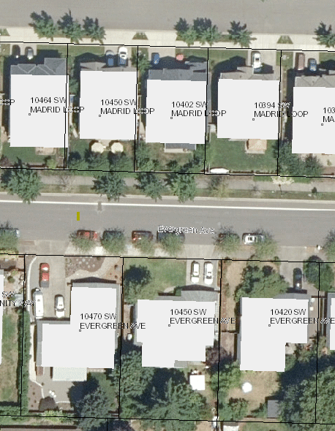
Lot Coverage Updates in Residential (R) zone [WC 4.122]
Current maximum: 30%
Revised standards for all development to scale up or down based on actual lot size (similar to standards in PDR zones)
Intended to make all housing (including middle housing) more feasible
Lot Size | Max Lot Coverage (all buildings)
20,000 sf or more | 25%
>12,000 sf to <20,000 sf | 30%
>8,000 sf to 12,000 sf | 50%
>7,000 sf to 8,000 sf | 55%
7,000 square feet or less | 60%

Slide 15
Old Town Design Standards
Need to update design standards to comply with state law
Design standards for middle housing can’t be more restrictive than for single-family
Standards must be clear and objective
Minimum changes for compliance
Example: Cannot require duplexes (or other middle housing) to “appear indistinguishable from single-family houses”
Potential for additional standards that promote good design (for future discussion)

Slide 16
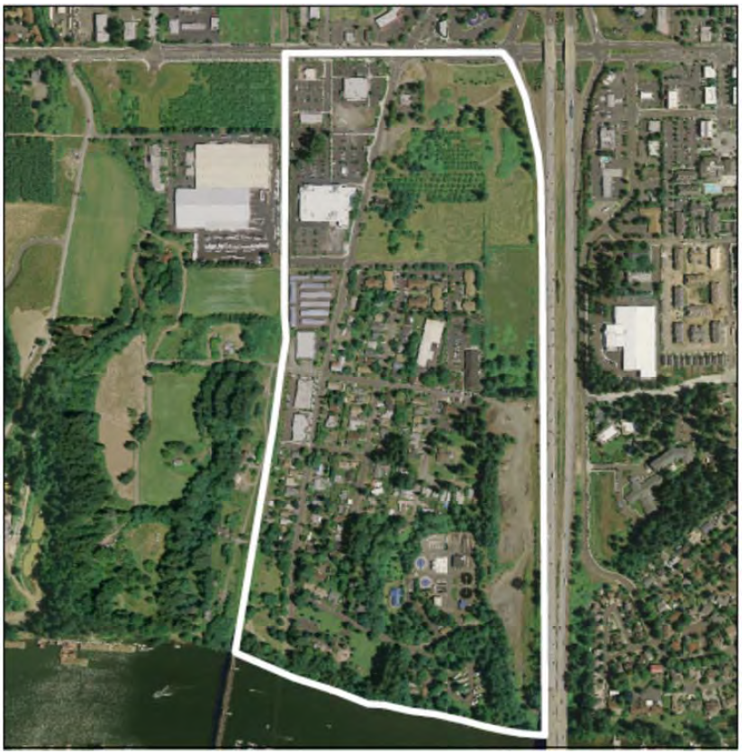
Old Town Neighborhood Plan
Updates to Chapter 6. Land Use
Summarize recent state laws regarding middle housing and ADUs (HB 2001 and SB 1051)
Reflect recent changes in ownership and development plans for specific lots
Reflect proposed changes to R and RA-H zones
Accessory Dwelling Units – Reflect code changes pursuant to state law

Slide 17
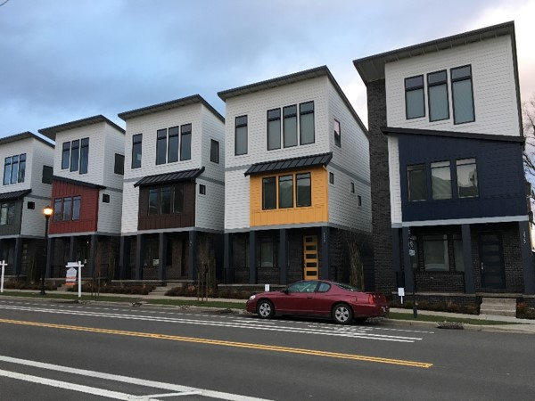
Villebois Village Master Plan and Village Zone [WC 4.125]
Planned density is over 10 units per acre (so state’s special Master Planned Community provisions apply)
Mostly built-out already
Master Plan / code amendments primarily needed to allow middle housing as infill/redevelopment in the future
Updates to V zone reflect:
Requirement to allow duplexes on any remaining single-family lots during initial buildout
Allowance for other middle housing after lots initially developed
OAR limits on siting and design standards

Slide 18
Survey
April 2021
86 responses
Primarily visual preference survey
Focus:
Siting and Design Standards
Parking

Slide 19
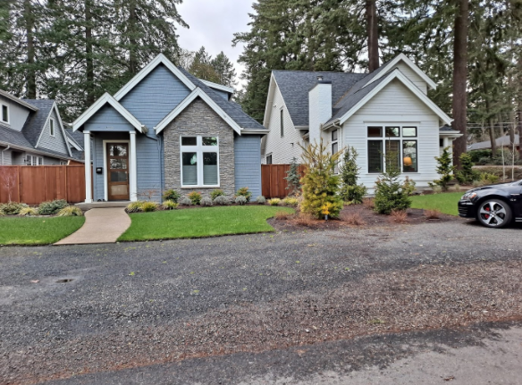
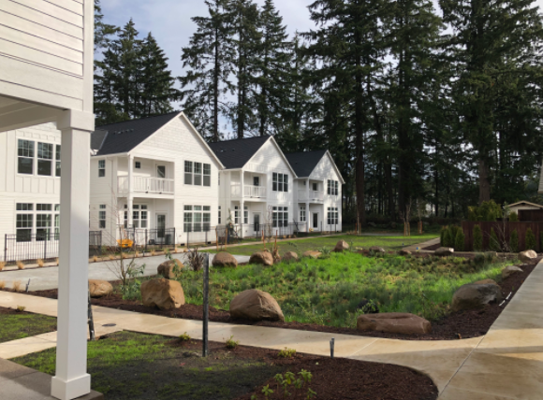
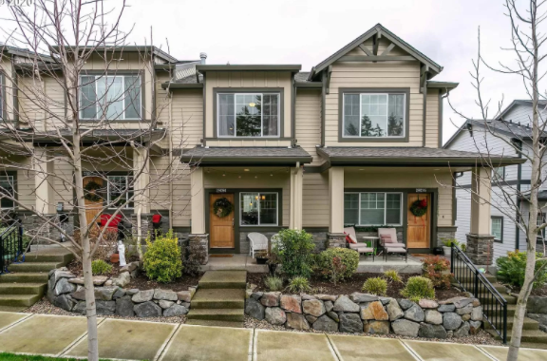
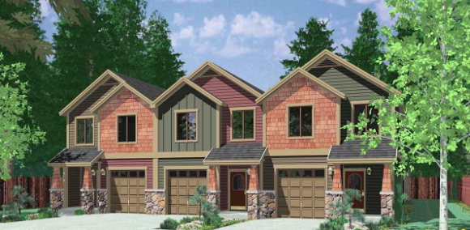
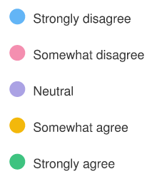
Survey Results: Adjacency

Slide 20
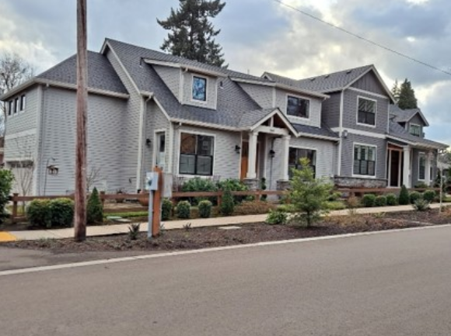
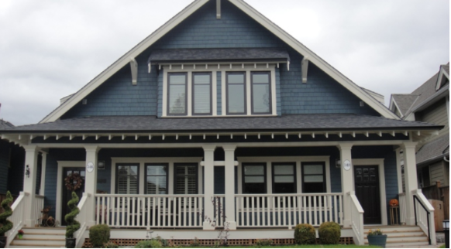
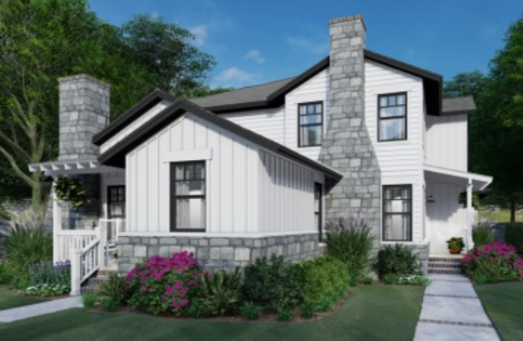
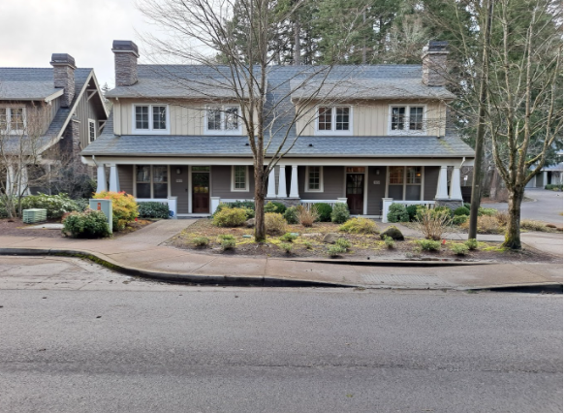
Survey Results: Single-family Look

Slide 21
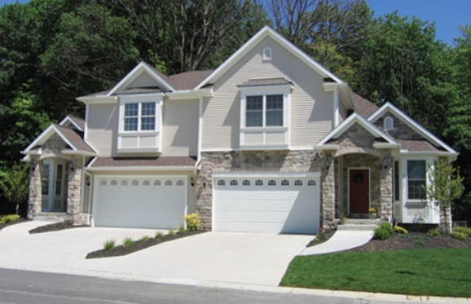
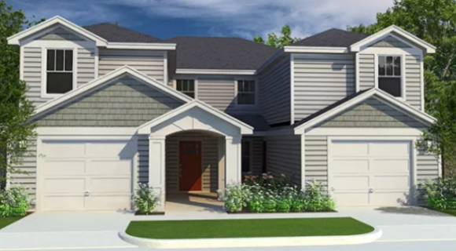
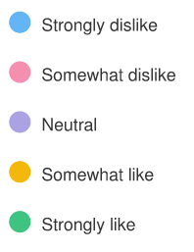
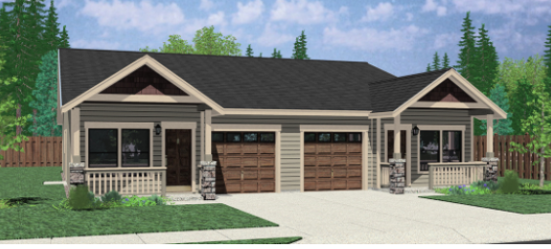
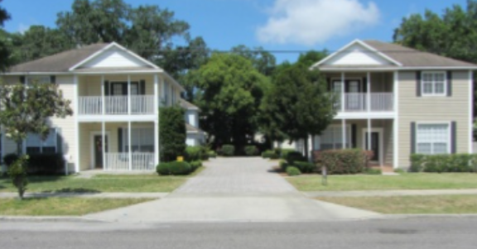
Survey Results: Driveway Separation

Slide 22
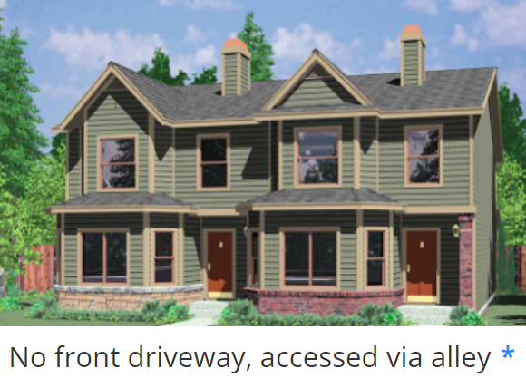
Survey Results: Alley Access

Slide 23
Survey Results: Lot Features and Amenities Priority
Feature or Amenity | Average Rank (lower is higher priority)
1. Garage | 2.88
2. Ample space between houses | 3.40
3. Houses detached rather than attached | 3.47
4. Large back yard | 3.78
5. Room for 2nd car in driveway | 3.82
6. Ample guest and visitor parking in driveway | 4.94
7. Large front yard | 5.71

Slide 24
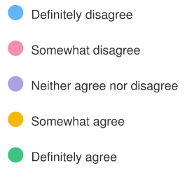
Survey Results: Shared Parking Trade-offs
Reduce lot size?
Reduce open space?

Slide 25
Frog Pond West Master Plan

Slide 26
Middle Housing Requirement Concept
Options
Existing
Likely
4 additional units
10%
35-55
units
15%
65-85
units
Match Allowed
About 138 units
Subarea Type | Existing % Req./# of Units | Example Concept-Low % Req./# of Units | Example Concept-Med.-High % Req./# of Units
R-10 | 0%/0 units | 5%/2 units | 10%/7 units
R-7 | 0%/0 units | 10%/13 units | 20%/28 units
R-5 | 10% if 10+ acres/4 units | 20%/7 units | 30%/11 units
Total | 4 added units | 22 added units | 46 added units
Notes:
Remaining uncommitted subdistrict are the white rows below.
Three scenarios are shown for implementing middle housing in FPW.
Column 5 is existing code/policy. It yield 4 new units.
Column 6 updates code to require a 5% (R-10), 10% (R7), 20% (R5) middle housing requirement. It yields 22 new units.
Column 7 updates code to require a 10% (R-10), 20% (R7), 30% (R5) middle housing requirement. It yields 46 units.

Slide 27
Additional Questions or Discussion?

